Slide 1



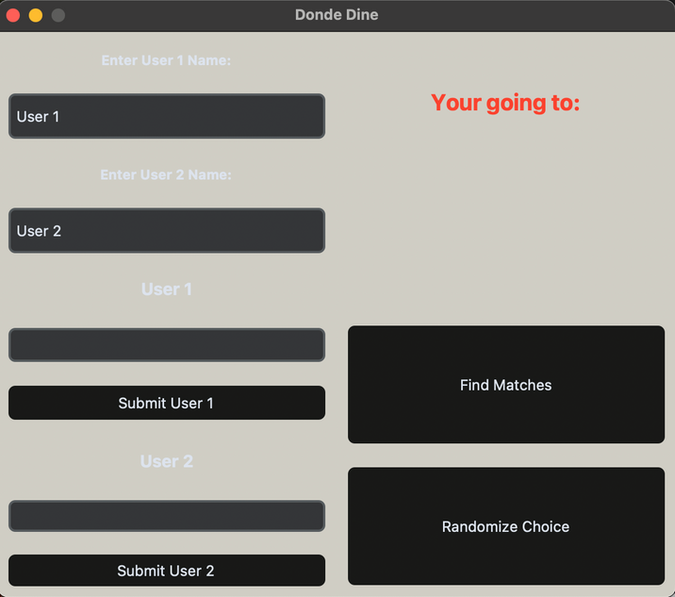
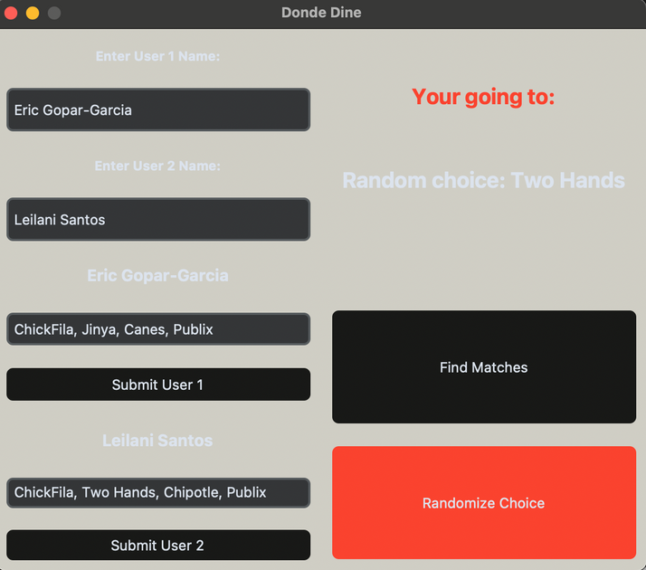


Helping Couples Decide On The Perfect Bite Without the Fight.
By: Eric Gopar-Garcia
Github Repository:https://github.com/ksu-is/DondeDine
Loading Screen
Finished Result
User Enters Name
Then Food Locations
Finally Submits responses
User Names on Top Left
Hover Over Buttons to Change Into Red Color
Choose to Match or Randomize Results

